Slide 1
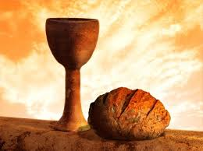
A Workshop on
Holy Communion as COVID restrictions are eased
Canberra Region Presbytery

Slide 2
Holy Communion as COVID restrictions are eased
Canberra Region Presbytery
Introductions
Prayer
Acknowledgement of Country
We acknowledge the first inhabitants of the places where each of us is located
and honour them for their custodianship of the land

Slide 3
Holy Communion as COVID restrictions are eased
Canberra Region Presbytery
Question:
Where are you up to,
in terms of preparing to have communion services
in person?

Slide 4
Holy Communion as COVID restrictions are eased

Slide 5
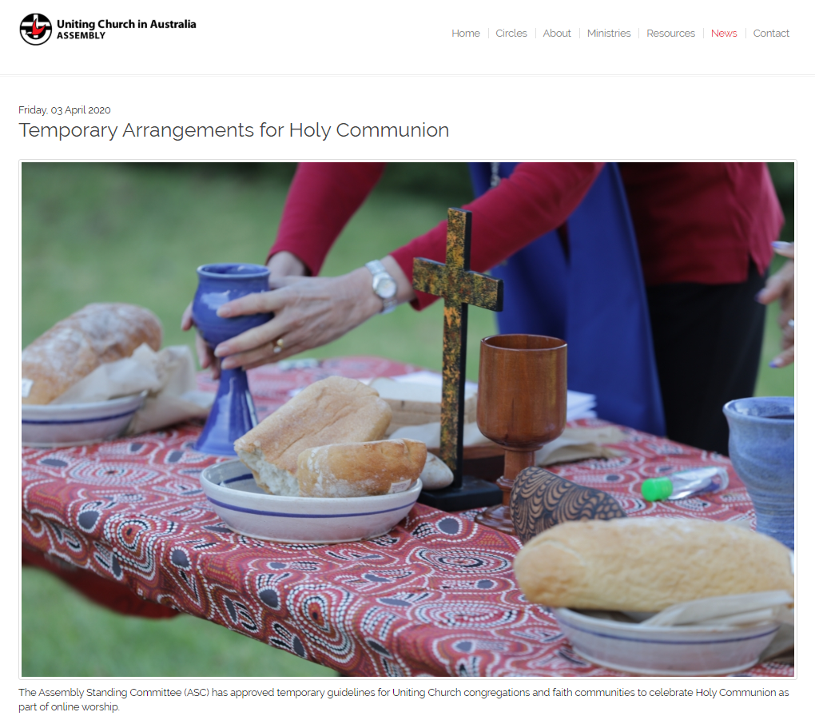
Holy Communion as COVID restrictions are eased
Assembly Standing Committee decision
“The decision whether to offer online Holy Communion in worship will be the responsibility of the Church Council with the Minister,” said Dr Palmer.
"There will be Uniting Church congregations and members, who choose not to celebrate Holy Communion in this way, but instead choose to wait until they are able to physically meet.”

Slide 6
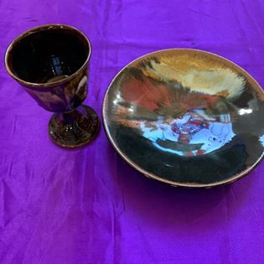
Holy Communion as COVID restrictions are eased
A Lament for Communion, written by the Rev. Elizabeth Raine
https://ruralreverend.blogspot.com/2020/03/a-lament-for-communion.html
A Liturgy of the Empty Hands by the Rev. Dr Amelia Koh-Butler
https://ameliakoh-butler.blogspot.com/p/the-sacrament-of-empty-hands.html

Slide 7
Holy Communion as COVID restrictions are eased
We will gather again in person—but when we do so, things will be different:
we will sit spaced apart (except for family groups), 1.5 metres from each other
we will practice social distancing, and follow the 4 square metre rule
we will provide contact details as we enter the building
we will use hand sanitizers on entering the building

Slide 8
Holy Communion as COVID restrictions are eased
When we gather for worship, there will be:
no hand shaking
no singing in groups
no passing the offering plate
no printed notice sheet or order of service
no hymn books or prayer books
no morning tea after service

Slide 9
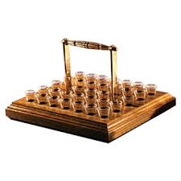
Holy Communion as COVID restrictions are eased
In Holy Communion:
no passing the bread around from person to person
no passing the tray of glasses from person to person
no common cup, no sharing sips from the one goblet
no intincting, dipping the bread into the cup before eating

Slide 10
Holy Communion as COVID restrictions are eased
Should we be looking to hold services that include the sacrament of holy communion, when we regather?
Is this an advisable practice, given all the health warnings about so many matters, of recent times?

Slide 11
Holy Communion as COVID restrictions are eased
How can we continue
in communion with God,
in this COVID 19 time?
rather than
When can we have communion again?

Slide 12
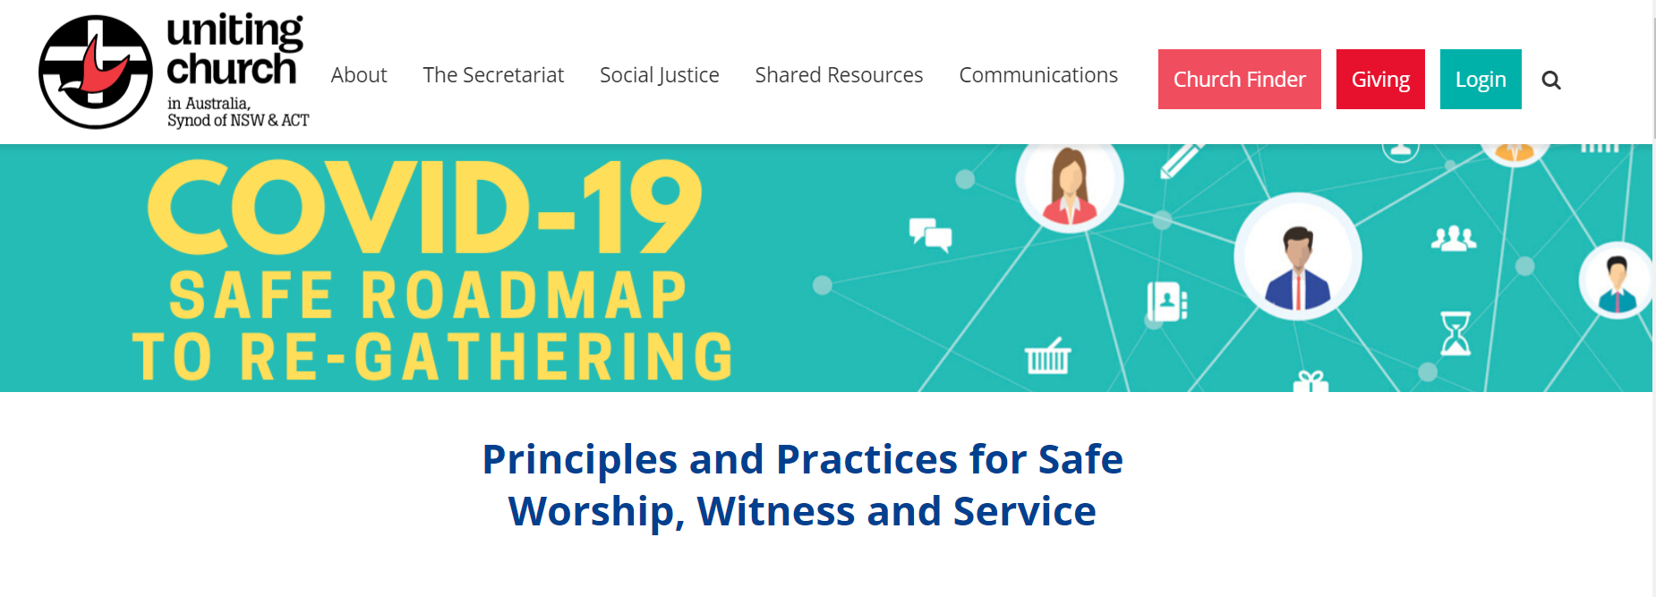
Holy Communion as COVID restrictions are eased

Slide 13
Gathering
as community
23 For I received from the Lord
what I also handed on to you, that the Lord Jesus
on the night when he was betrayed took a loaf of bread,
24 and when he had given thanks, he broke it
and said, "This is my body that is for you.
Do this in remembrance of me."
25 In the same way he took the cup also, after supper, saying, "This cup is the new covenant in my blood.
Do this, as often as you drink it, in remembrance of me." 26 For as often as you eat this bread and drink the cup, you proclaim the LORD's death until he comes.

Slide 14
Gathering
as community
17 Now in the following instructions I do not commend you, because when you come together it is not for the better but for the worse.
18 For, to begin with, when you come together as a church, I hear that there are divisions among you; and to some extent I believe it.
19 Indeed, there have to be factions among you, for only so will it become clear who among you are genuine.

Slide 15
Gathering
as community
20 When you come together, it is not really to eat the LORD's supper. 21 For when the time comes to eat, each of you goes ahead with your own supper, and one goes hungry and another becomes drunk.
22 What! Do you not have homes to eat and drink in? Or do you show contempt for the church of God and humiliate those who have nothing? What should I say to you?
Should I commend you?
In this matter I do not commend you!

Slide 16
Gathering
as community
27 Whoever, therefore, eats the bread or drinks the cup of the Lord in an unworthy manner will be answerable for the body and blood of the Lord.
28 Examine yourselves, and only then eat of the bread and drink of the cup. 29 For all who eat and drink without discerning the body, eat and drink judgment against themselves. 30 For this reason many of you are weak and ill, and some have died.
31 But if we judged ourselves, we would not be judged.
32 But when we are judged by the Lord, we are disciplined so that we may not be condemned along with the world.

Slide 17
Gathering
as community
So,
when CAN
we have
communion,
then?

Slide 18
Seeking the continuing
presence of Christ
The Uniting Church acknowledges that the continuing presence of Christ with his people is signified and sealed by Christ in the Lord’s Supper or the Holy Communion, constantly repeated in the life of the Church. In this sacrament of his broken body and outpoured blood the risen Lord feeds his baptised people on their way to the final inheritance of the Kingdom.
Basis of Union, paragraph 8

Slide 19
Seeking the continuing
presence of Christ
Thus the people of God, through faith and the gift and power of the Holy Spirit, have communion with their Saviour, make their sacrifice of praise and thanksgiving, proclaim the Lord’s death, grow together into Christ, are strengthened for their participation in the mission of Christ in the world, and rejoice in the foretaste of the Kingdom which Christ will bring to consummation.
Basis of Union, paragraph 8

Slide 20
Seeking the continuing
presence of Christ
… Christ who is present when he is preached among people is the Word of God who acquits the guilty, who gives life to the dead and who brings into being what otherwise could not exist …
Basis of Union, paragraph 4

Slide 21
Seeking the continuing
presence of Christ
Thus the people of God, through faith and the gift and power of the Holy Spirit, have communion with their Saviour … Basis of Union, paragraph 8

Slide 22
Seeking the continuing
presence of Christ
Serving Holy Communion (A paper prepared by the Assembly Commission on Liturgy in 1984, updated in 1999 and 2015.)
In the two Uniting Church Services of the Lord’s Day, the rubric says the distribution of the bread and wine shall be ‘according to local custom' (UIW 2, p.182, 221). But how many local customs are there?

Slide 23
Seeking the continuing
presence of Christ
Serving Holy Communion (A paper prepared by the Assembly Commission on Liturgy in 1984, updated in 1999 and 2015.)
The view of the Worship Working Group is that we should all rejoice in this rich diversity of local custom, that we should all be familiar with the various ways in which other congregations serve Holy Communion, and that every congregation should have some diversity of practice within its own sacramental life.

Slide 24
Seeking the continuing
presence of Christ
Thus the people of God, through faith and the gift and power of the Holy Spirit, have communion with their Saviour, make their sacrifice of praise and thanksgiving, proclaim the Lord’s death, grow together into Christ, are strengthened for their participation in the mission of Christ in the world, and rejoice in the foretaste of the Kingdom which Christ will bring to consummation.
Basis of Union, paragraph 8

Slide 25
Finding Communion with God
What are the ways
that we enter into communion with God?

Slide 26
Finding Communion with God
prayer and meditation
reading scriptures and reflecting on the words we read
fasting, often in association with prayer

Slide 27
Finding Communion with God
sharing with a small group of people in fellowship, conversation, and prayer for one another
a sabbath time for rest and focussing attention on God

Slide 28
Finding Communion with God
Chastity
Poverty
Obedience
the classic “counsels of perfection”

Slide 29
Finding Communion with God
The means of grace
preaching the Word
the sacraments of holy communion and baptism
the practices of prayer, almsgiving, and fasting

Slide 30
Finding Communion with God
Wesleyan “works of mercy”
visiting the sick and those imprisoned, feeding and clothing those in need (Matt 25)
financial activities: earning, saving, giving
service toward communal or societal needs, such as seeking justice, opposition to slavery, other social justice issues

Slide 31
Finding Communion with God
Can we still have communion with God, without celebrating holy communion?

Slide 32
Finding Communion with God
What are the issues
of hygiene and distancing
that are involved in
“the way we normally
do communion” ?

Slide 33
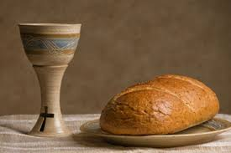
Communion The practicalities
If communion is offered, then those who prepare communion
will need to be scrupulous in the way that they prepare the elements

Slide 34
Communion The practicalities
A common cup
should not be used
Passing trays of individual glasses from person
to person along the row runs the risk of multiple touching of the same object

Slide 35
Communion The practicalities
Passing a loaf of bread for each person to break off a piece also involves multiple touching
How the bread and the wine are distributed need to be carefully explored
One person at the front passing each item to each participant also means that multiple touching is involved

Slide 36
Communion The practicalities
One option for a congregation
with smaller numbers is placing
the elements spaced out on the table
for each individual to collect
their own piece of bread and glass
Another option is that individuals or family groups could continue to do what they have done
during the period of online worship—prepare
their own bread and wine or juice—and bring
that from their home to the worship service

Slide 37
Communion The practicalities
If communion is offered, then those responsible for collecting and cleaning the communion items will also need to be scrupulous in minimising their physical contact with places in the building, and also meticulous in cleaning and storing the communion items

Slide 38
Communion The practicalities
It may be that a Church Council decides that the Congregation will forgo communion whilst meeting in person,
until a vaccine has been developed
and made available.
A Lament for Communion
Rev. Elizabeth Raine
https://ruralreverend.blogspot.com/2020/03/ a-lament-for-communion.html
A Liturgy of the Empty Hands
Rev. Dr Amelia Koh-Butler
https://ameliakoh-butler.blogspot.com/p/ the-sacrament-of-empty-hands.html

Slide 39
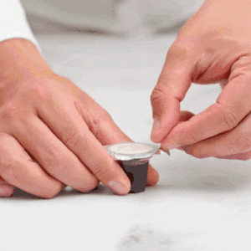
Contactless Communion ??
The environment
“The plastic cup [is] made from Polypropylene (PP)”
but only 1-2% of PP is ever recycled
The ethics of fair trade
“Apologies, we do not have any supply chain certifications that we can provide.”

Slide 40
Conclusion
How do we work locally
to make decisions
and communicate
those decisions?

Slide 41
Conclusion
deciding
Ministers and Pastors
Elders
Lay Presiders
Church Council
Congregational Meeting

Slide 42
Conclusion
communicating
Word of mouth
Phone calls
Emails
Newsletters
Social media

Slide 43
Holy Communion as COVID restrictions are eased
Thank you
for your
participation
in this
workshop

Slide 44
Holy Communion as COVID restrictions are eased

